Slide 1
End User Training
Teams Overview

Slide 2
CBC Team-Please Update this according to your specifications
How to create a team:
Submit a helpdesk ticket by emailing ishelp@columbiabasin.edu, requesting your team with your planned Team name and members
Once the Team has been created, IS will notify you and make you a team owner.
As a team owner, you’ll be able to customize your team. See the following slides for best practices

Slide 3
Teamwork & Learning Hub
Teamwork & Learning Hub
Create Collaborative Classrooms
Connect Educators and Professionals
Streamline Staff Communications
Notes:
So let’s talk about what Microsoft Teams is and some of the things you might want to use teams for:
Create collaborative classrooms that save faculty time and better engage students in modern learning
Connect educators in professional learning communities to improve teaching skills with built-in PLC Notebooks
Streamline staff communication on school-wide initiatives using custom Staff Notebooks in Teams
Come together in a team for any team or project, like student groups or planning events
Teams has everything you’ll ever need to connect from anywhere.

Slide 4
Teamwork & Learning Hub
Teams Structure
Team
Channel
Channel
Conversations
Files
Notes
Tabs
Connectors
Conversations
Files
Notes
Tabs
Connectors
Notes:
Now that we know a little more about what Teams can be used for, let’s shift gears to better understand the structure of Teams.
A Team is created to bring individuals together in a single space for collaboration.
Within a Team you can create Channels – the channel is a space within a Team that allows you to build sections or workstreams – we’ll talk more about examples and use cases later, but know this is a way to separate/section out the Team if needed.
Within every channel you have conversations, files, notes, tabs and connectors.
Conversations – this is the space where you can communicate with the channel or team, provide updates, reply, etc
Files – this is where you can store any files you have associated with that channel
Notes- this is where you can house notes regarding the channel
Tabs- tabs allow you to basically bookmark certain apps, files, or integrations to make them easily accessible
Connectors- connectors allow you to connect third party and native integrations – bringing things like MS Forms, MS Planner, blackboard, etc to keep all work related to that channel in a single location.

Slide 5
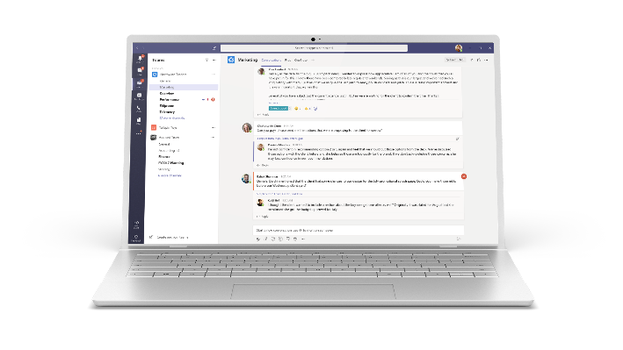
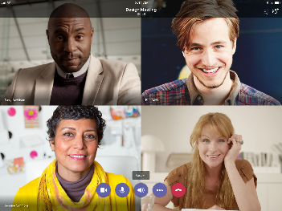
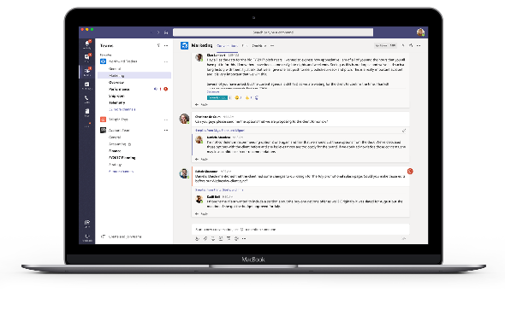
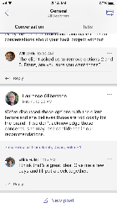
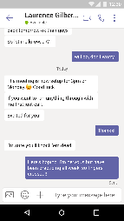
Teamwork & Learning Hub
Mobility & Accessibility
Desktop
Tablet
Browsers
Windows 7+
Phone
Edge
Chrome
Firefox
OS X 10.10+
iPhone
Android
Notes:
Microsoft Teams provides a seamless collaboration and communication experience that is accessible regardless of the type of device and browser being used.

Slide 6
Teamwork & Learning Hub
Types of Teams
Class
Discussions, group projects and assignments
Professional Learning Community (PLC)
Educator working group
Staff
Staff leaders and staff members collaborating on school administration and development
Other
Students and school employees collaborating in clubs, study groups, and after school activities
Notes:
When creating a Team for the first time there are four types of Microsoft Teams templates that are preconfigured and can be used to get you started: a Class, PLC, Staff and Other.
Many of you who are leveraging MS Teams for the classroom, may have the necessary Team structure and information (including student rosters) imported by the IT team.

Slide 7
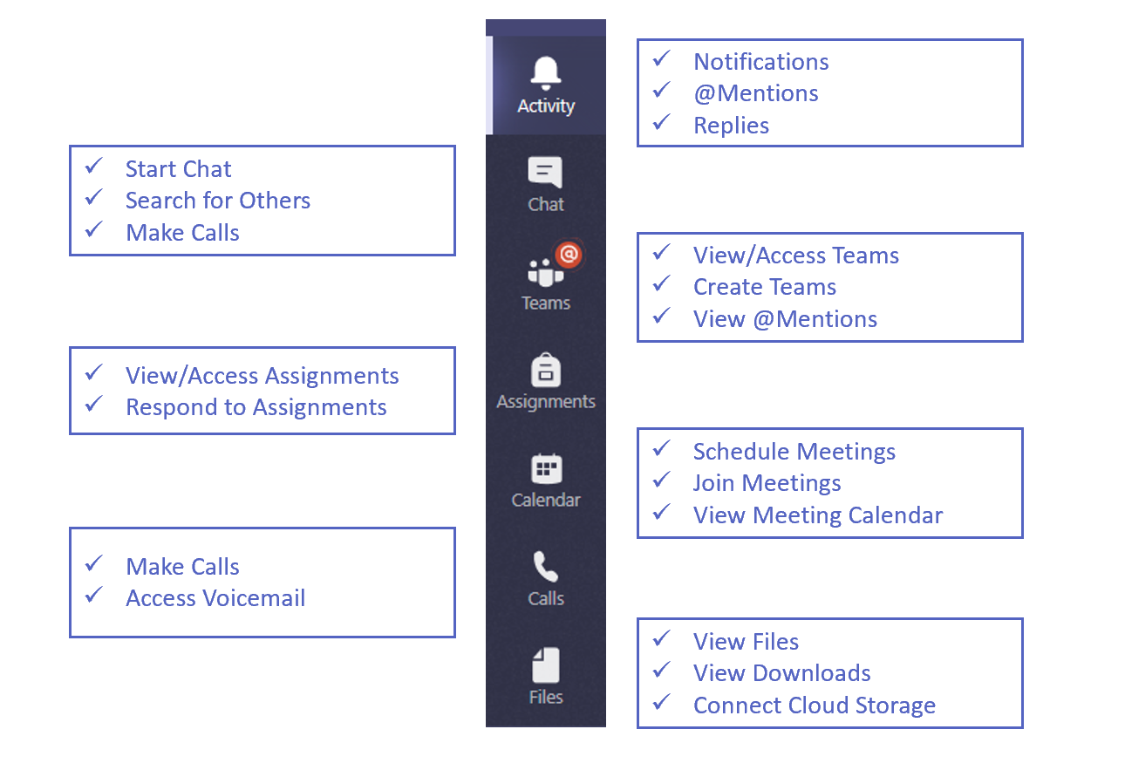
Teamwork & Learning Hub
Microsoft Teams Overview
Notes:
So now that we’ve talked about a few ways you can use Teams, I want to show you what it looks like;
Once you log in for the first time, you’re going to see this layout…
If you look at the top left of your screen, you’ll see the familiar waffle icon where you can launch your favorite office apps like word, excel, and powerpoint.
Next, I want to call your attention to the left vertical menu. We call this the Navigation bar, with each of the icons representing different apps.
Let’s start with the activity app, where you will be notified when someone @mentions you in a conversation, replies to existing conversations, and other important alerts. – This is where you will start your day, get updates from overnight and what you need to follow up on.
The chat app will keep all of your group and personal chats organized, initiate voice and video calls, and search for classmates or teachers you want to chat with.
The teams app houses all of the existing teams you belong to, this is where you can create new teams if your institution allows this, and another place where you can view any @mentions for a specific team.
The calendar app allows you to schedule meetings, study sessions, and events. You can join meetings and organize your day right inside this app.
The calls app may be disabled and may not appear in your Teams client, but for those that have the calls app, this is where you will make calls, access a dial pad and access voicemail
The Files app allows you to view files, downloads and connect cloud storage like onedrive or dropbox
And the assignments app will allow you to view, access, and respond to all of your assignments from one convenient place

Slide 8
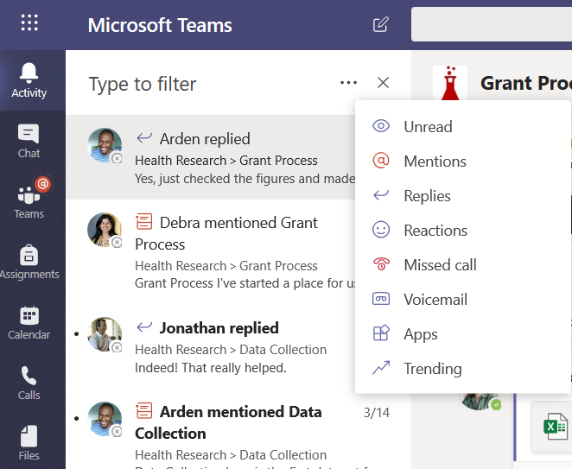
Teamwork & Learning Hub
Microsoft Teams Overview
Pick and choose what you see in the Activity Tab and Filter by content type
Notes:
The activity app on the navigation tab allows you to see all activity that impacts you.
You can see unread messages, @mentions, replies to your messages or conversations, updates on things you are following, you’ll also see likes on your comments, posts, etc.
If you happen to miss a call or have a new voice message then you can view/listen to it here.
The filter button will allow you to pick and choose what you see – if you only want to see missed calls, simply filter and view.

Slide 9
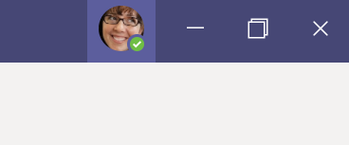
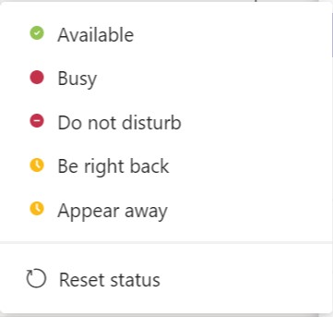
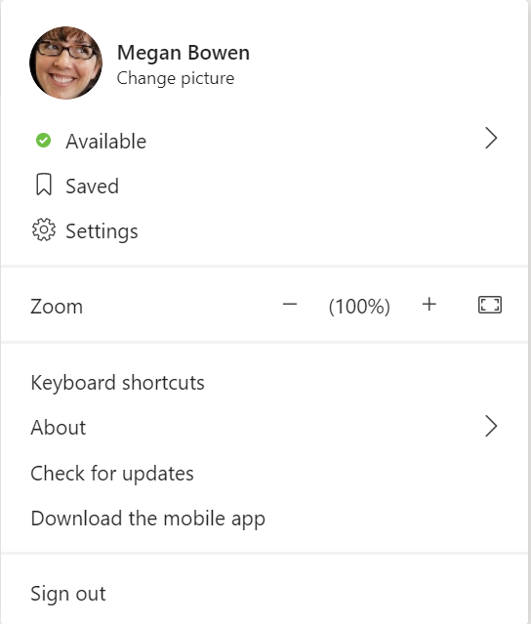
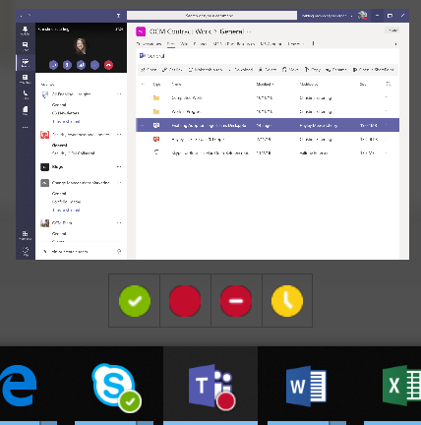
Teamwork & Learning Hub
Online Presence in Teams
Click your photo in the top right corner of Teams
This menu allows you to:
Update your status
View saved messages
Update settings
Zoom in and out
Download the mobile app
Sign out of Teams
You can also change your status by hovering your mouse over the Teams icon in your start bar.
Notes:
Update your status between any of those listed above. Teams automatically updates your status to Away after 5 minutes of idle time

Slide 10
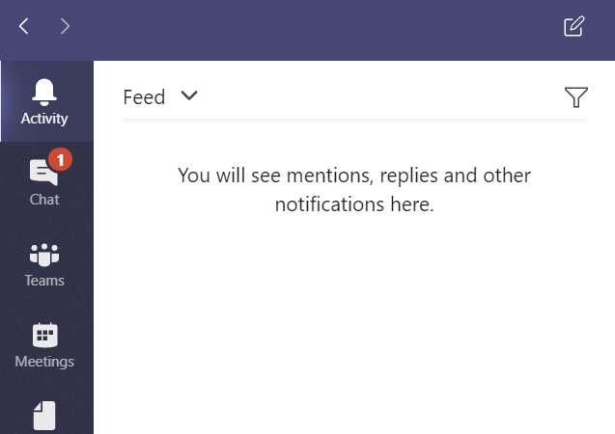
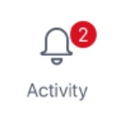
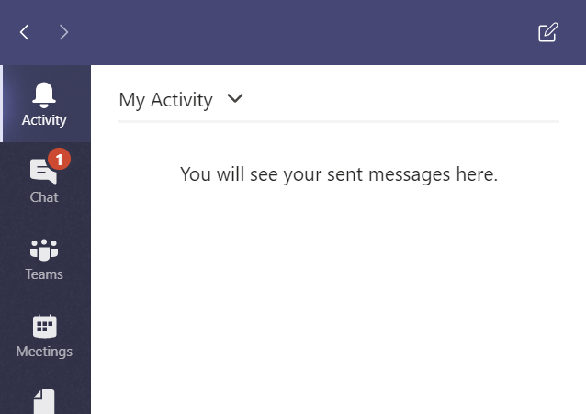
Teamwork & Learning Hub
Activity Menu
If you have replies or @mentions, you will see a red notification bubble, which will stay for 14 days or until you read the notifications.
The Activity menu allows you to quickly see any replies or @mentions to you by selecting Feed from the drop down, or you can see your personal activity by updating the drop down to My Activity.

Slide 11
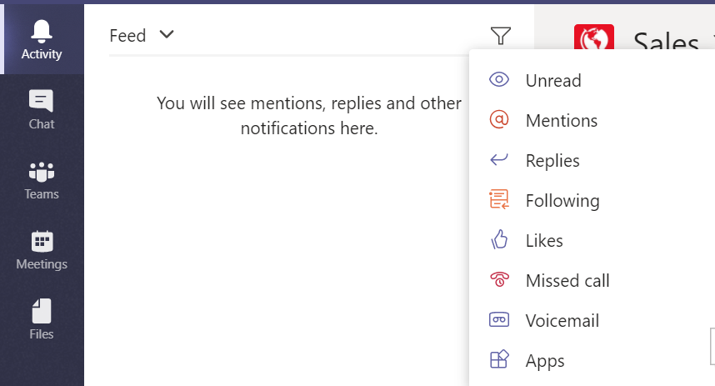
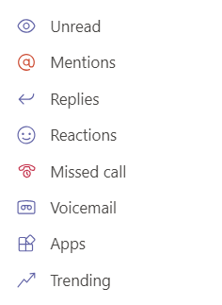
Teamwork & Learning Hub
Activity Menu
Within the Activity menu, in the Feed or My Activity options, you can filter by clicking the filter icon then selecting how you want to filter the lists. You may choose from Unread notifications, @mentions, Replies, and more.
Notes:
In addition to @mentioning an individual person to gain their attention, you can also @mention an entire Team or Channel so that all members of those groups will receive a notification that new content has been posted and they should review.
Team owners need to turn this option on using the Manage Meetings option on the teams maintenance menu we will see in a few slides.

Slide 12
Teamwork & Learning Hub
Chat Menu
The Chat menu is where you handle interactions with individuals, separate from your public Teams activities.
In the Chat menu, you can view and respond to Recent interactions and access your Contacts list.
After choosing a contact, you’ll see sub-menus below their name:
Conversation – Holds ongoing chats with you and contact (private from others).
Files – Holds files you and the contact have shared.
“+” – Adds new tabs for your contact connection.
Organization – View your contact’s position in the organization.
Activity – Shows activity between you and the contact within common teams/channels.
Select the New Chat icon to start a new private chat conversation with an individual or a group. Conversations will display in the Chat menu
Notes:
NOTES:
Conversation subtab: Chats occurring here are persistent, meaning they are always there and just keep going. They can be referred to and won’t disappear just because you close the Teams program.
Chat menu conversations are between you and your contact, plus anyone else you may have added to the chat.
These are appropriate for random conversations, not relating to a team or a channel.
Conversations relating to topics within a team or channel should take place within that space so they can be searched and added to the persistent chat viewable to the full team.

Slide 13
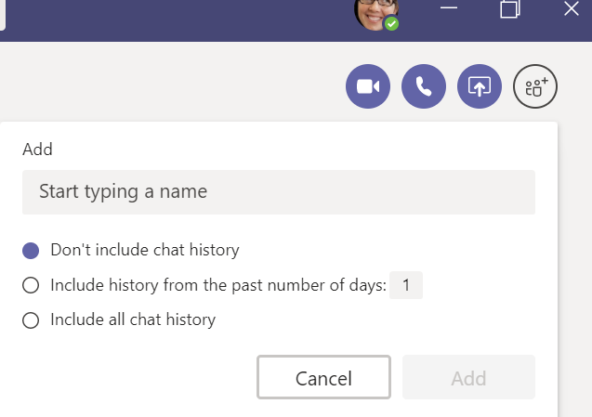
Teamwork & Learning Hub
Chat Menu-Update Title/Subject, Add Participants
You’ll eventually build a list of conversations. To help quickly locate a specific conversation, you can update the title to the discussed topic:
1. Locate and select the chat from the list.
2. Click the pencil icon to the right of the contact list.
3. Type the desired chat name in the space, click Save.
To add participants to an individual chat, in the top right corner, select the Add People button and begin typing a name in the box.
Here you may also choose what previous chat history to share with the new contact. Select the option that best fits and click Add.

Slide 14
Teamwork & Learning Hub
Chat Menu- Files Shared in Private or Group Chats
You can share files in private 1:1 chats or group chats (those initiated from the Chat menu, not the Teams menu).
Those files shared in private chats are automatically stored in the OneDrive for Business folder and are only accessible by those within that conversation.
You may access those files by clicking the Files tab within the conversation.
Important Note: The OneDrive files you see in Teams are associated with your Office 365 account – not your personal OneDrive. Teams can’t currently connect to your personal OneDrive.

Slide 15
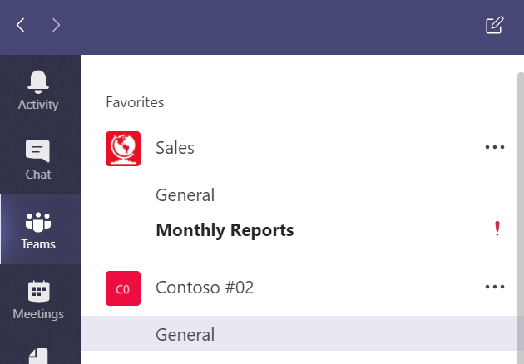
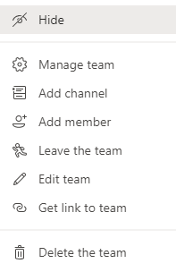
Teamwork & Learning Hub
Teams Menu- Teams vs. Channels vs. Tabs
When you select the Teams menu, you will see a list of Teams and Channels appear – this is where the work really gets done.
A team is a group of people gathered to get something big done. Teams can have up to 2,500 members.
Teams are made of channels, which are the conversations you have with your teammates. Each channel is dedicated to a specific topic, department, or project.
You can access additional team options by selecting the three dots to the right of the team name.
Notes:
REMOVE FAVORITE: Allows you to make a team a favorite, which will ensure it shows at or near the top of your Teams menu. You can also remove the favorite selection here.
MANAGE TEAM: If you are the team owner, this allows you to do things such as:
Change the team picture.
Set member permissions (like allowing them to create, update, or delete channels and tabs).
Enable @team or @[team name] mentions in a channel.
Set permissions for guests.
Enable team members to send GIFs, emoji, and stickers.
Renew the team.
ADD CHANNEL: Allows the team owner to add a new channel.
LEAVE THE TEAM: Allows you to leave the team, which means you will also be leaving all associated channels. You can leave a team on your own, but only an admin can remove you from an organization.
GET LINK TO TEAM: Generates a link that can be sent to another individual for them to join the team. They would simply copy and paste the link into a browser and follow the prompts.

Slide 16
Teamwork & Learning Hub
Teams Menu- Teams vs. Channels vs. Tabs
Beneath the Team name, you will find Tabs – added organization for quick access to information within your team.
Conversations – This is where your team conversations take place and are viewable by everyone on the team. Here you can like a comment, reply directly to a teammate, or @mention a colleague, the team, or a channel to get their attention.
Files – This tab houses all files shared among your team members. You may also add or upload a new document to share, get the direct file link to share with others, add additional storage, or access files in SharePoint.
Notes:
Other Common Tab Additions:
BOTS / CONNECTORS – Create these tabs to have notifications and content from 3rd party apps and news feeds dropped into a channel where the whole team can view it.
MICROSOFT PROGRAMS – Add quick access to other Microsoft programs like Planner for assigning and tracking tasks for a project, Power BI for project management resources, PowerPoint to keep presentations handy, and more. We’ll see how to add a Planner on the next slides.
LINKS TO OUTSIDE RESOURCES– Link to outside websites containing frequently accessed resources.

Slide 17
Teamwork & Learning Hub
Teams Menu- Conversations in Chat vs. Teams
Reminders:
Chat menu conversations are private and viewable only to participants in that chat
These conversations should not be applicable to topics in teams or channels
Conversations within channels are related to the team/channel, are viewable to the entire team, are searchable and act as an ongoing record.
Within the teams/channels conversations, ensure that you:
Always @mention a user, team or channel in Team or Channel conversations to draw attention to action required
Use Reply when responding to a conversation thread
Like conversation or chat messages to acknowledge receipt

Slide 18
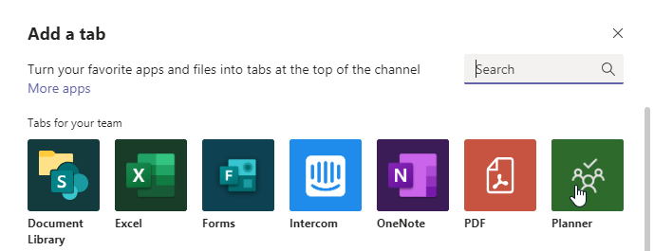
Teamwork & Learning Hub
Teams Menu- Adding a Planner to Tab
Planner provides easy access task assignment and tracking for projects within your team. These can be added to a team or a channel.
Start by clicking the + at the end of the existing tabs.
Next select or search for the program you want to add. For this example, select Planner.

Slide 19
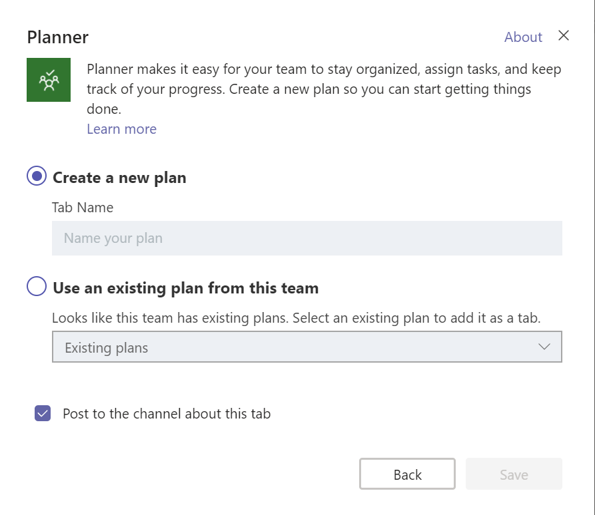
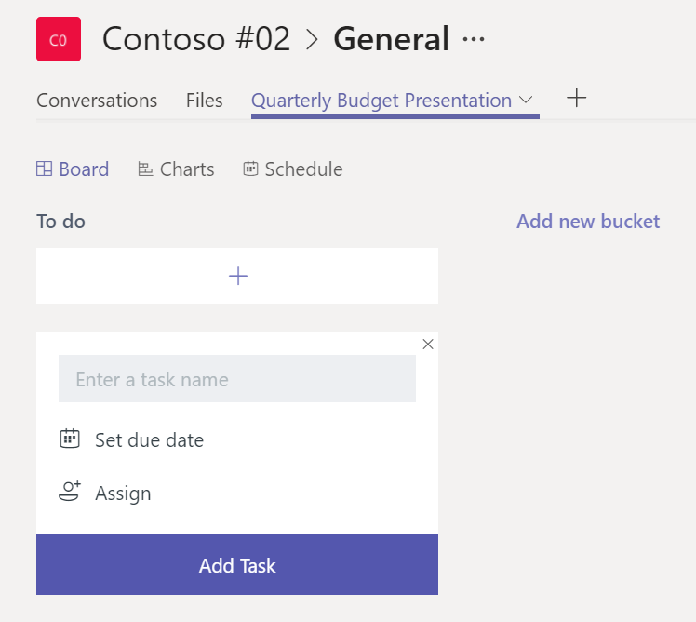
Teamwork & Learning Hub
Teams Menu- Adding a Planner to Tab (cont’d)
Next, you will Create a new plan and type in the name of the plan or project. Our new plan is called Quarterly Budget Presentation.
After selecting Save, you can begin entering to-do tasks with due dates and assignments. You can add as many tasks and assignments, as necessary. These tasks can be marked In Progress and Completed as progress is made.

Slide 20
Thank you.

